Slide 1


Cloud Computations
Weather Prediction
INSY-695-076
Advanced Topics in Information Systems: Enterprise Data Science & ML in Production II

Slide 2





About Our Team
Cloud-Computations
Jake Hogan
Role: Data Analyst
Duncan Wang
Role: Product Manager /Data Analyst
Steven Liang
Role: Product Manager
Hanna Swail
Role: Data Scientist /
UX/UI Specialist
Richard Gao
Role: Business Analyst
/ Architect

Slide 3
Current Processes
“The evidence suggests that the benefits of investing [...] hydrometeorological system needed for climate services outweigh the costs by about 80 to one.” - WMO
Social & Economic Benefits
Numerical weather prediction uses mathematical models of the atmosphere and oceans to predict the weather based on current weather
Several shortcomings…
Long computation time
Expensive data collection sources (radar, satellites...)
Access is geographically constrained
Agricultural planning
Sustainable Development
Transportation Hazard planning
Demand forecasting by utility companies
Climate change Adaptation
While existing models have been successful, there is still a significant opportunity for machine and deep learning models to improve the accuracy and geographic availability of traditional weather forecasting.
Notes:
https://arxiv.org/pdf/2002.00469.pdf
https://public.wmo.int/en/media/press-release/benefits-of-investments-climate-services-agriculture-and-food-security-outweigh
https://royalsocietypublishing.org/doi/10.1098/rsta.2020.0097

Slide 4
Main Objectives
Use Time-series weather data to forecast average daily temperature (*C) in Montreal, QC, using classical time-series and SOTA models
Use Machine Learning models to explore causal relationships between variables
Display anomalous temperature points based on historical patterns
Package and Deploy the model for industry use and on-demand predictions
Compare Models
Anomaly Detection
Causal Inference
Model Deployment
LSTM, ARIMA, XGBoost, RF GAM, AutoML
Using Autoencoders via Keras
Business explainability for meteorologists
Docker/Streamlit Dashboard/fastapi

Slide 5


Hypothesis/Problem Statement
“In the last couple of years, several studies have pioneered data-driven, global, medium-range weather prediction. All of them show that there is some potential in this approach but also highlight the need for further research.” - Rasp et all.
Meteorological Observations
End-user forecast products
Hypotheses
Simple parametric models such as ARIMA will have a lower prediction error than more complicated machine learning or neural network models when given just past temperature patterns as a predictor to forecast future temperatures with (with no exogenous variables)
Neural Network models will perform best when a large variety of predictors are available, since they are generally more capable of identifying and capturing any hidden variable relationships, when present, that might not be visible to the human eye.
The best explanatory factor for temperature will simply be the most recent available past temperatures.
Notes:
https://arxiv.org/pdf/2002.00469.pdf

Slide 6
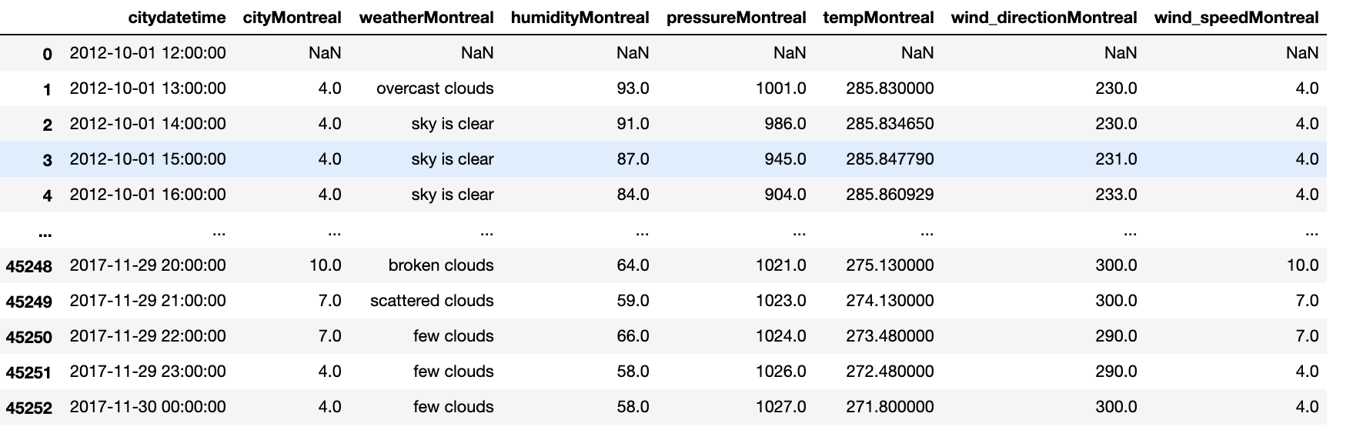
Dataset Introduction
1 Datetime variable hourly measurements
4 Numerical Variables
Temperature, Humidity, Wind Direction, Wind Speed
1 Categorical Variable
Textual description of weather
Data Collected for the city of Montreal using openweathermap API, from 2012-2017
The nature of weather data is highly complex and non-linear, but also exhibits some recurring patterns, only on local scale

Slide 7
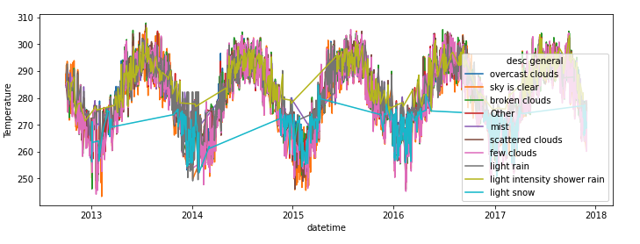
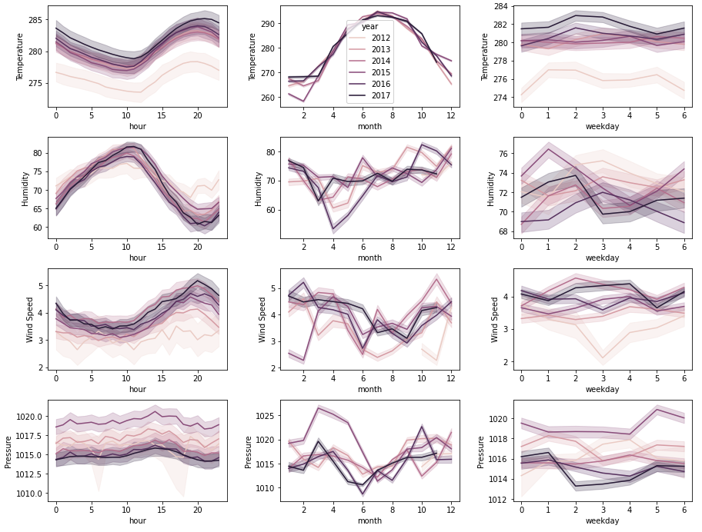
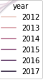
Dataset Exploration
Temperature, Humidity, Pressure, wind speed had calendar hourly trend
Temperature also had a monthly trends
There seems to be an upwards yearly trend in Temperature
Data was collected from October 2012, which is why its distributions seem to be different

Slide 8
Data Preprocessing
Categorical Feature Preprocessing
38 unique descriptions
Cleaned/standardized word notation
Replaced similar notations/rare occurrences (sleet & snow, smoke → other)
Standardized intensity values (few & light)
Dummify weather events: Clouds, rain, mist, snow, shower, thunderstorm, fog
Set Intensity score column: Clear = 0, light = 1, medium = 2, heavy = 3
Used Iterative Imputer to replace missing values:
Humidity → 1696
Temperature → 3
Pressure → 994

Slide 9
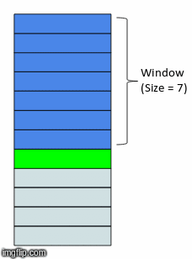
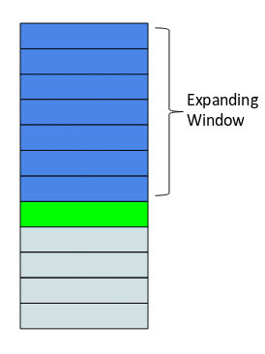
Feature Engineering
Extract year, month, quarter, day, weekday, week, hour minute, whether it was the beginning or end of a month….
Time variable extraction
Using temperature from previous hour, 2 days, 12 days and 30 days as predictors
Lagged Features
Extract {maximum, minimum and average} for previous {daily, monthly, weekly} for all features {temperature, humidity, wind direction, wind speed, pressure}
Aggregate Lagged Features
Rolling Window
Expanding Window
Average {temperature, humidity, wind direction, wind speed, pressure} from t-24 to t-1
Total average {temperature, humidity, wind direction, wind speed, pressure} from the t_0 to t-1

Slide 10
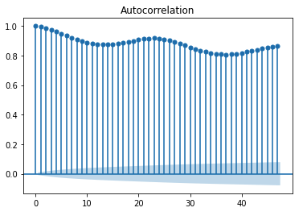
Feature Selection
RFE utilizing Decision Tree Regressor
Autocorrelation Plot for Temperature
max daily temp
min daily temp
min daily wind speed
min weekly temp
mean weekly hum
mean weekly pressure
rolling_mean_temp
rolling_mean_pressure
rolling_mean_wind_dir
Rolling_mean_wind_speed
rolling_mean_humidity
Humidity
Wind Direction
Pressure
Wind Speed
hour
lag1
lag2
lag12
lag30

Slide 11
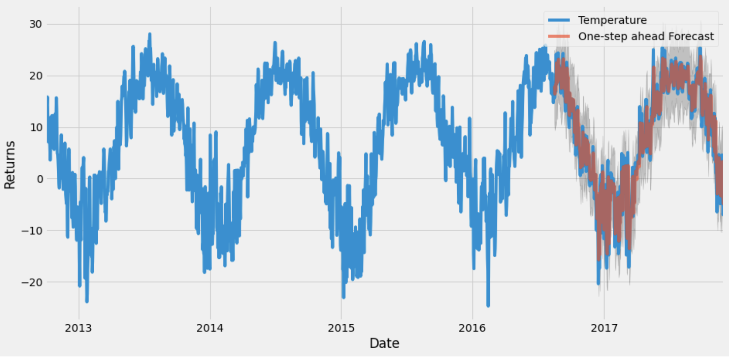
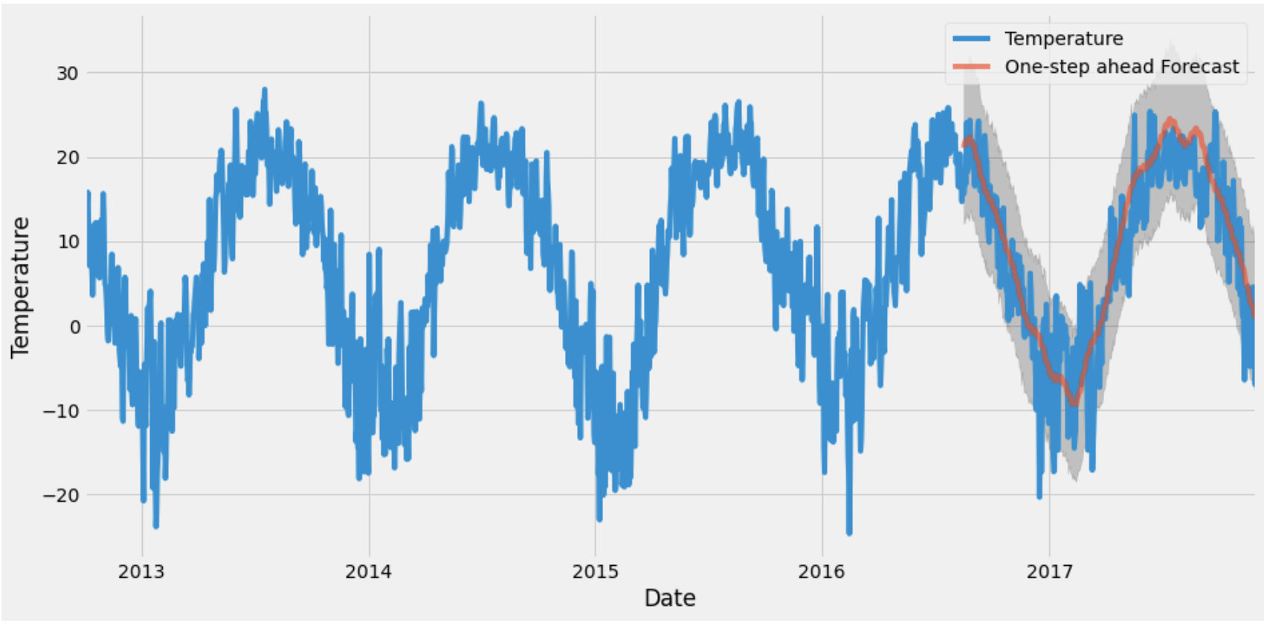
Parametric Models:
Seasonal ARIMA (SARIMA)
Generalized Additive Model (GAM) w/ FbProphet
Supports the direct modeling of the seasonal component of the series (unlike ARIMA) with three new hyperparameters to support the seasonal component of the series
Number of autoregressive terms or lags (p, P)
Amount of differencing - number of past time points to subtract from the current time point (d, D)
Number of moving average terms - lags of forecast error (q, Q)
the period of the seasonality (s)
(Big letters = seasonal level parameters)
Gridsearch is used to determine optimal ARIMA and seasonal
parameters.
MAE = 2.57
75% TRAIN
25% TEST
split for all models
Prophet is a procedure for forecasting time series data based on an additive model where non-linear trends are fit with yearly, weekly, and daily seasonality, plus holiday effects.
MAE = 3.75
Notes:
Duncan

Slide 12
Machine Learning Models
Notes:
First, we compare ML models using only lagged temperature features and time features. XGBoost performed the best, with MAE of 2.77.
We added new lagged variables for descriptive status, humidity, wind direction, pressure and wind speed and tested this on XGBoost → MAE decreased to 2.42, and better than SARIMA.
We then performed Bayesian hyperparameter optimization using Hyperopt on both models, as well as AutoML using Ludwig Time-Series Forecasting
Model | Features | Hyperparameter tuning | MAE
XGB | Lag temp + time | No | 2.77
XGB | Lag temp + time | Yes | 2.70
XGB | Lag temp + whole feature set | No | 2.42
XGB | Lag temp + whole feature set | Yes | 2.46
RNN - Ludwig | Lag temp only | NA | 2.85
Hyperparameter tuning has minimal effect on the model.
Features used to predict the temperature could be much more important than the hyperparameters themselves
Adding new features improves the model, but marginally
Notes:
Duncan
Additional features helped the model
Hyperparameter tuning did not

Slide 13
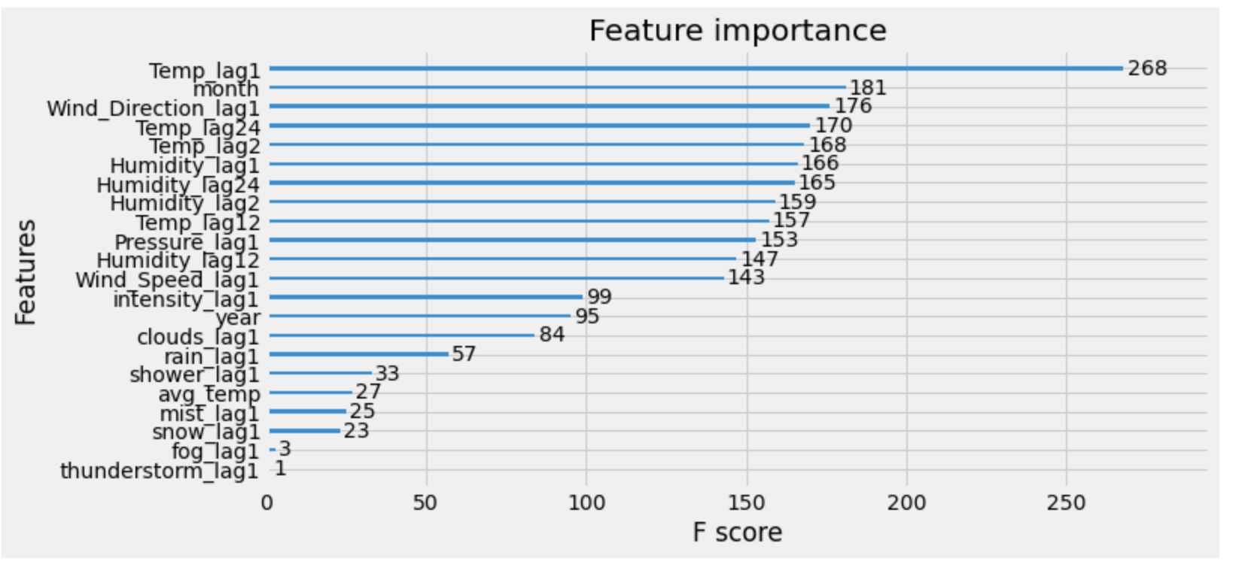
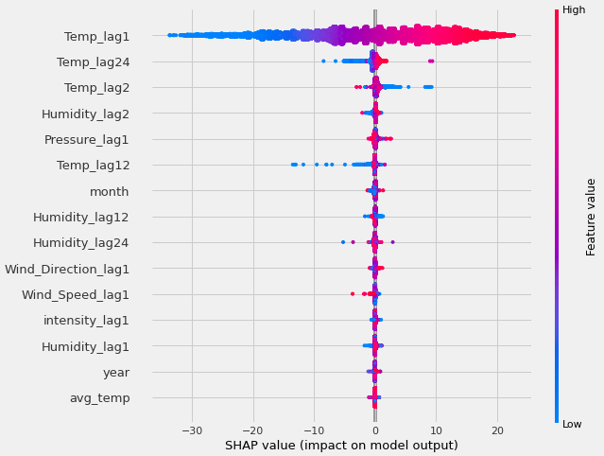
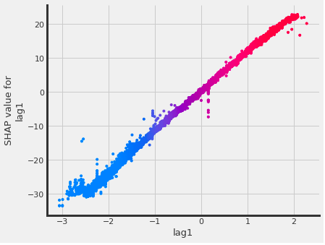
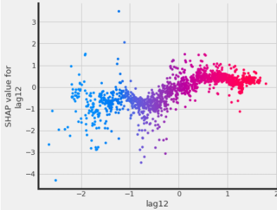
Modeling: ML Models Business Interpretation
Lagged temperature features are the most important. Lagged humidity and pressure also hold greater importance, as well as month.
SHAP Values Analysis
Lag1 is symmetrical overall and directly proportional.
Previous low temperature is associated with lower current temperature.
High previous temperature is associated with higher current temperatures.
SHAP : 1 Feature
Notes:
Duncan

Slide 14
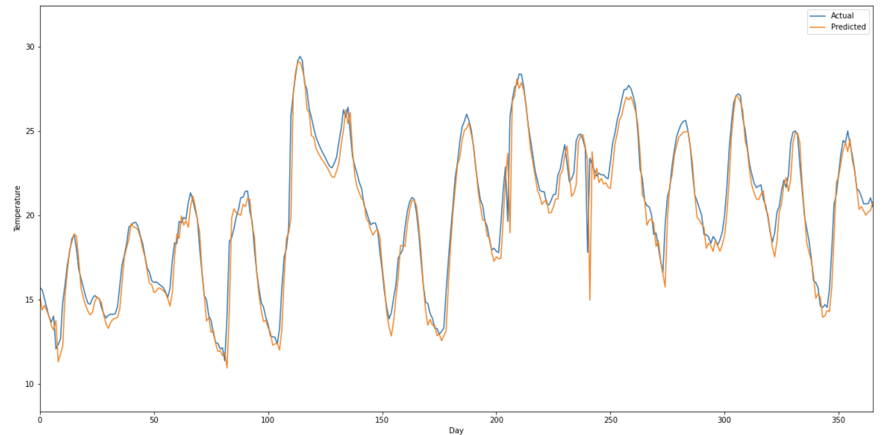
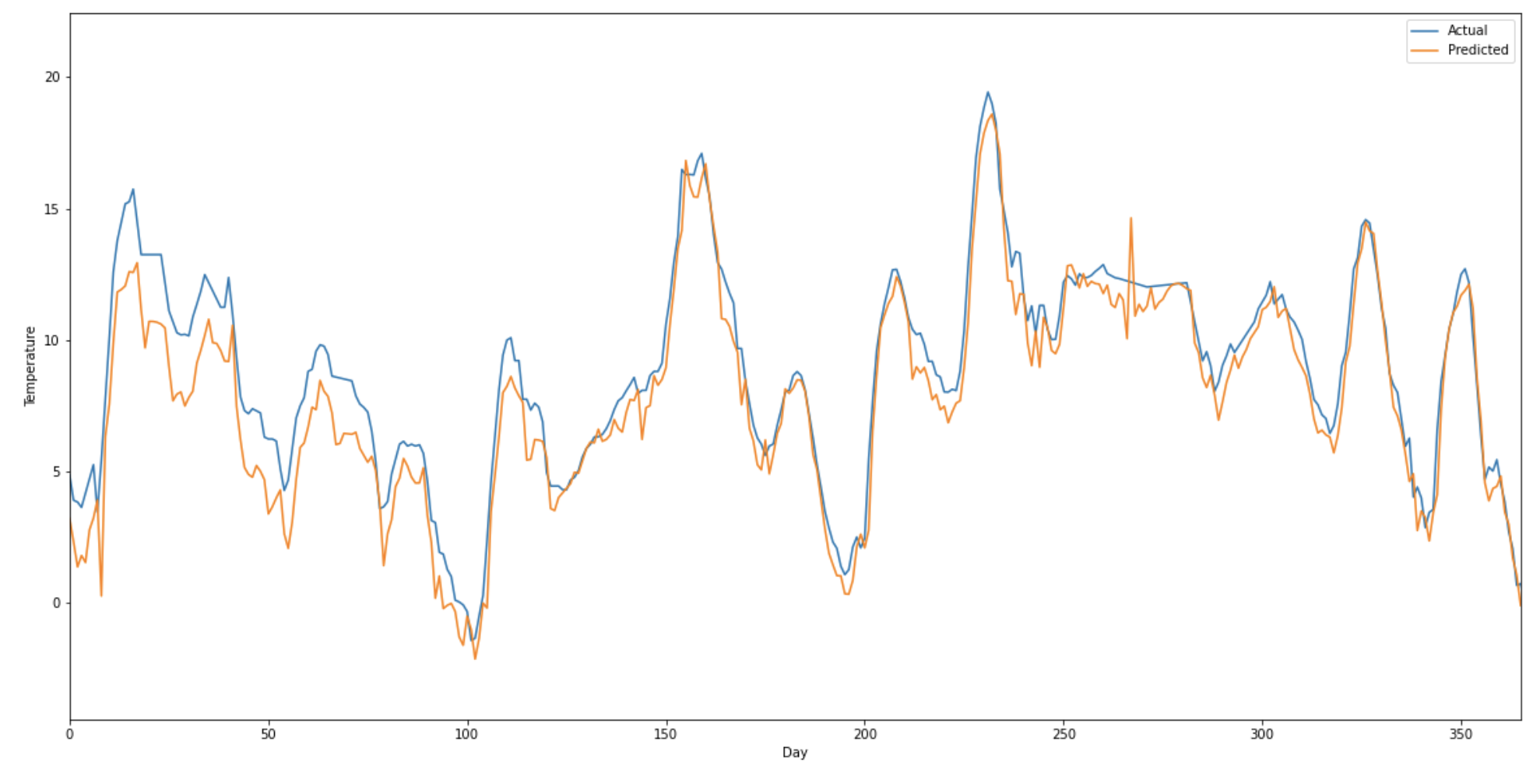
Neural Networks: LSTM
Several models were created and tested with varying complexity
Simple Model:
Inputs: Sequence of recent temperatures
Outputs: Prediction of temperature in the next period
MAE: 2.689
Complex Models:
Inputs: Multivariate sequences of important features (as per RFE)
Outputs: Prediction of temperature in the next period
MAE: 3.133
Notes:
Jake

Slide 15

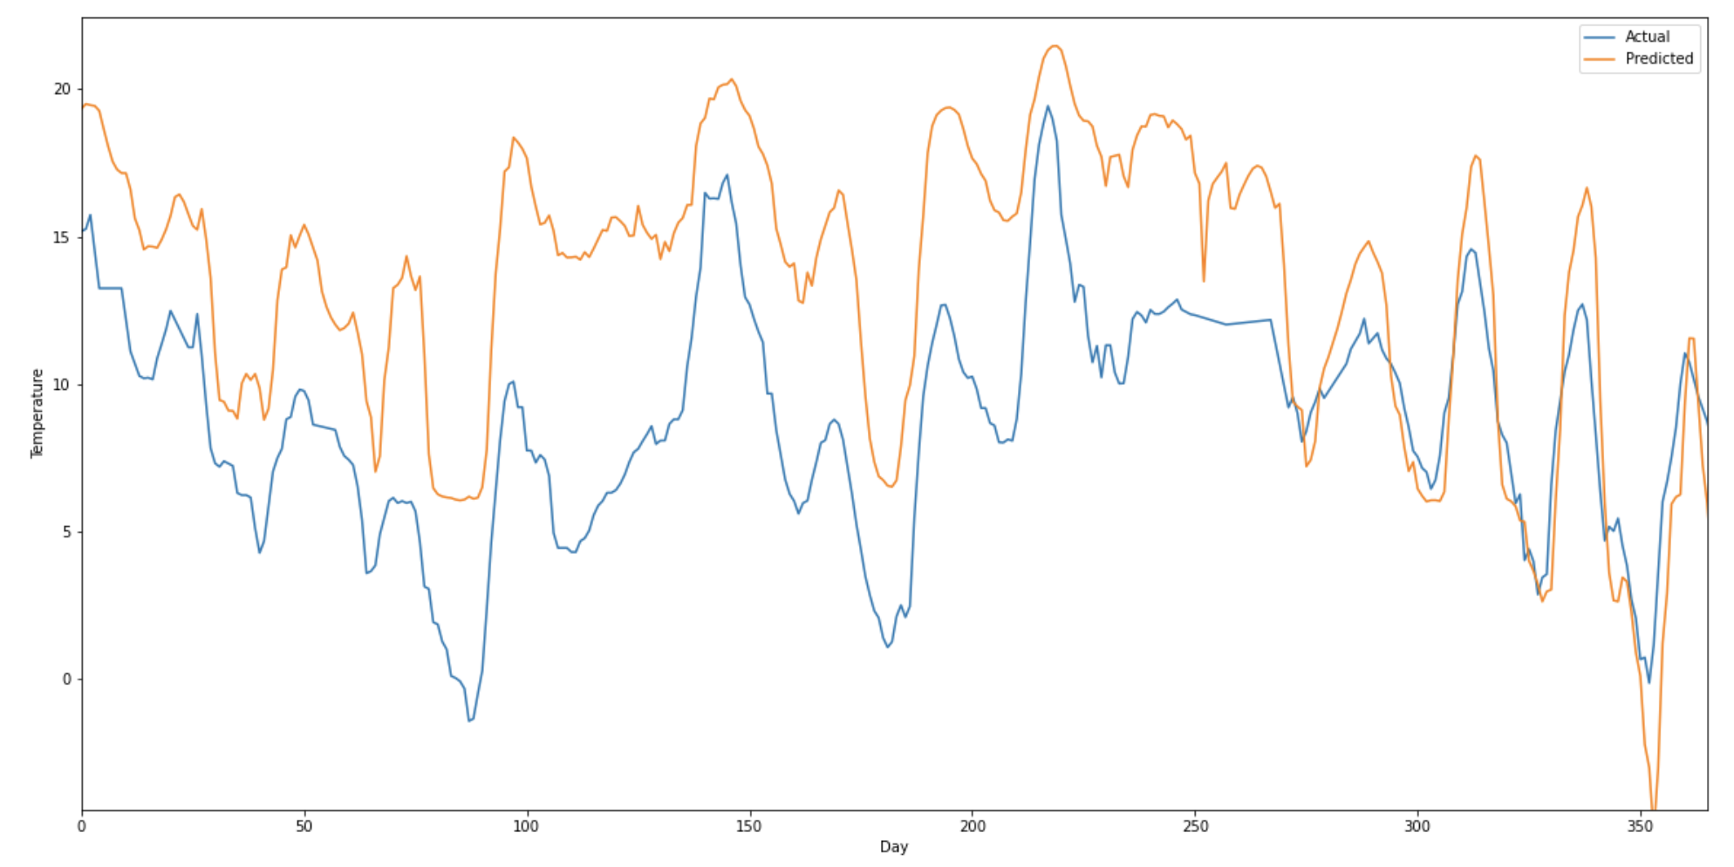
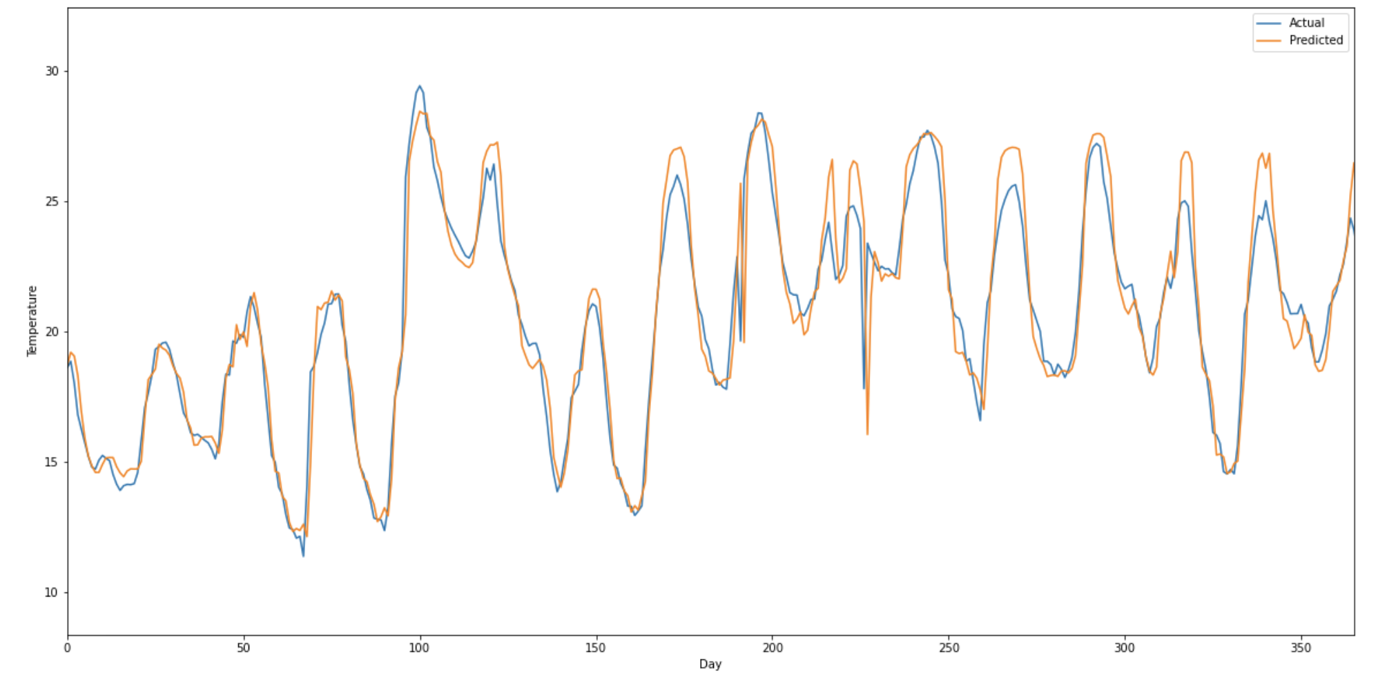
Neural Networks: Transformers
What are transformers?
Transformers are a SOTA neural network model which uses the attention mechanism
Attention
Looks at each element of an input sequence and decides which other parts of the sequence are most relevant to that element
Performance
Low performance on the weather prediction task
MAE (Complex): 6.024
MAE (Simple): 3.851
Multivariate Inputs
Simple Inputs
Notes:
Jake

Slide 16
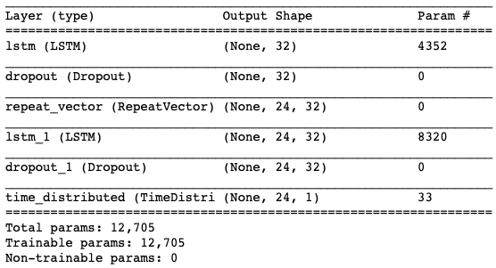
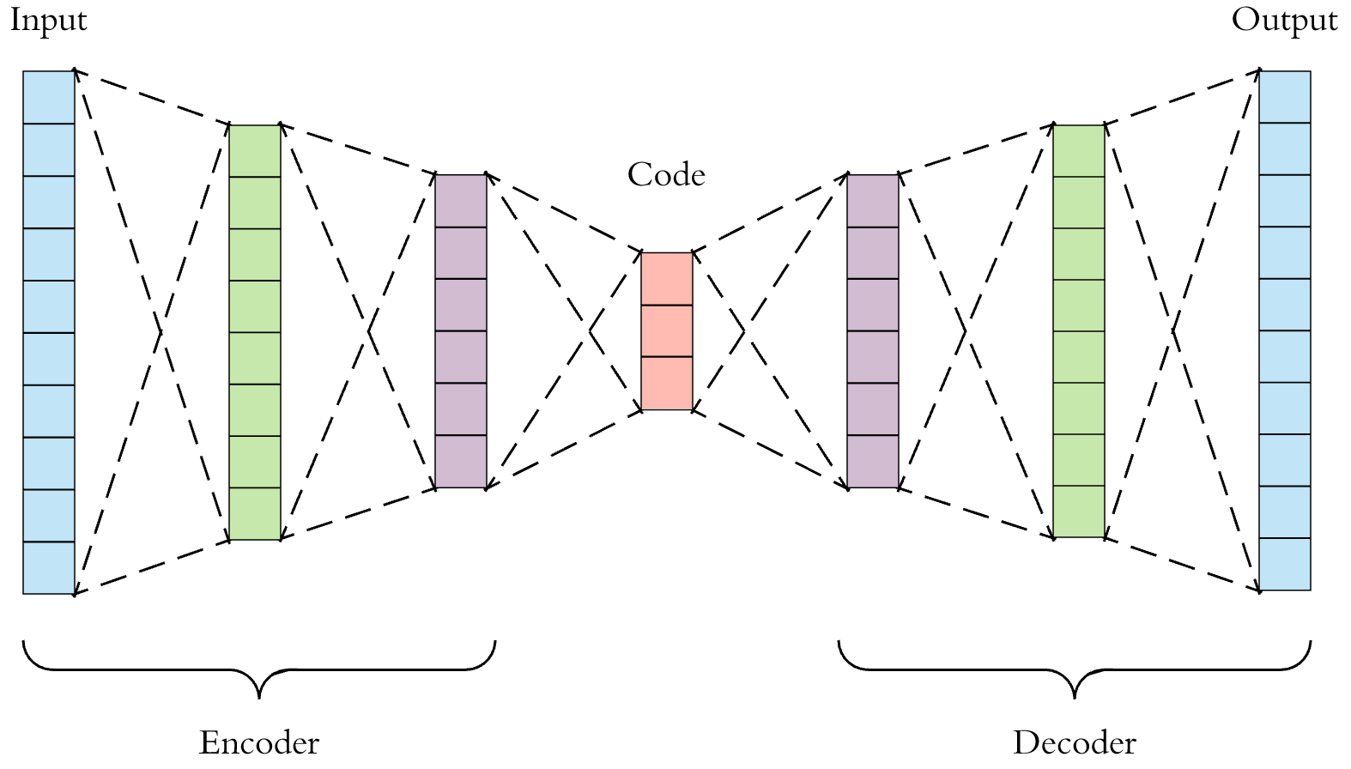
Time Series Anomaly Detection
We employ a Sequential Model using Keras as an Autoencoder
Reads an input sequence into a hidden representation
Representation is fed to a decoder to reconstruct the input sequence
The difference between y_pred and y_test gives an error; points with errors above the set threshold are considered anomalies
Anomalies refer to predicted results that differ significantly from actual results, and give us information about critical events (in this case critical temperature events)
Notes:
https://medium.com/swlh/time-series-anomaly-detection-with-lstm-autoencoders-7bac1305e713
Jake

Slide 17
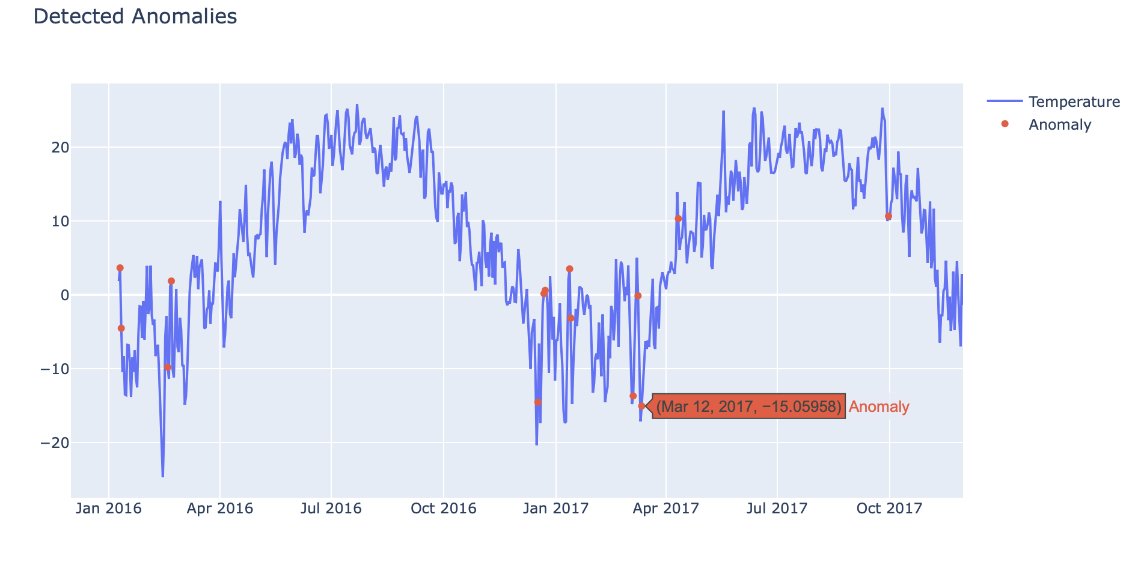
Time Series Anomaly Detection: Output
The red dots are anomalies that represent time points with abrupt changes in existing temperature
Notes:
Jake

Slide 18
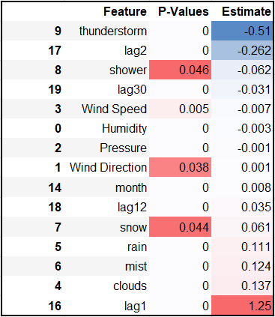
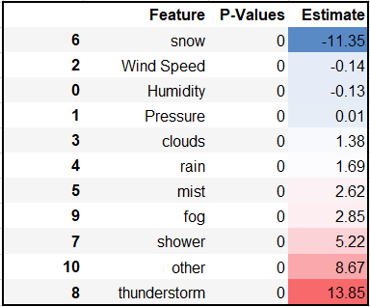
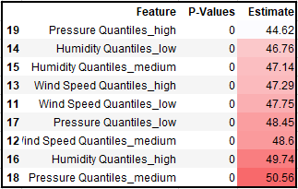
Causal Inference using DoWhy
Base Variables seem more intuitive
Engineered variables can have strange and mixed results
General Insights
Continuous to categorical: Humidity, Wind Speed and Pressure
For example:
Snow → lowers temperature
Thunderstorm → increases temperature
Analyzing Causal Effects of Treatments (features) on Outcome (Temperature)
Initial Test: All Variables
Test 2: Weather
Test 3: Engineered Features

Slide 19
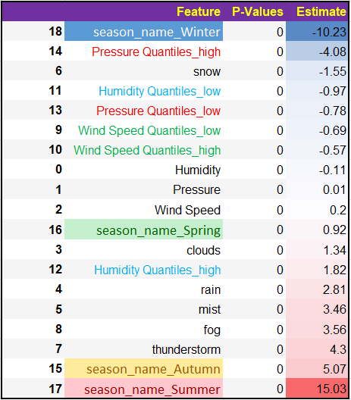
Analyzing Causal Effects of Treatments (features) on Outcome (Temperature)
Final Causal Inference Model:
Simplified categorical variables
High and low
Seasons added in for context and additional insights
Humidity, Pressure and Wind Speed on its own are not insightful but with high vs low distinctions
Different weather patterns associated with the temperature spectrum

Slide 20

Hypothesis Validation
Threats to Validity
Next Steps
The best explanatory variables were past temperature values (lag1)
Neural Networks did not perform best with a large variety of predictors. However, adding extra features to XGBoost did improve performance, though marginally.
ARIMA did outperform XGBoost with the simple set of features, but XGBoost was the most performant when including all features.
Different locations could have different relationships between features
Test the models/causal inference for different cities → one model for all cities or one model per city?
Multi-step forecasting for long-range forecasts (direct or recursive?)
Notes:
https://machinelearningmastery.com/multi-step-time-series-forecasting/

Slide 21
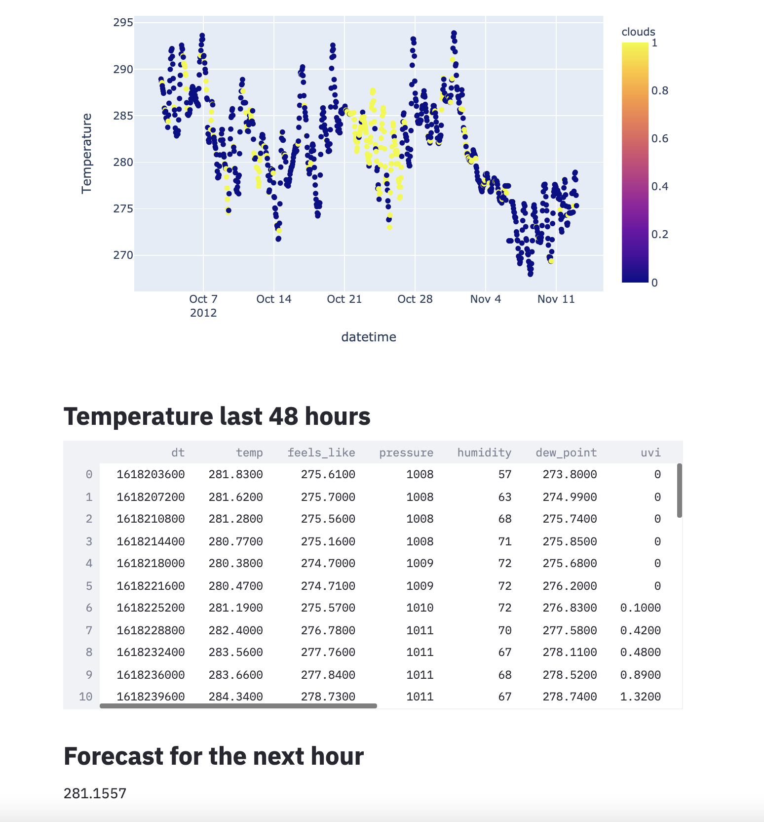
Packaging and Model Deployment
Model:
The model is trained from data stored in AWS S3. Before training, we run KL-divergence on the loaded data to compare it to previous training data. The divergences, models and rmse are logged onto mlflow. The model is then pickled to be used by a fast-api application.
Fast API:
In order to deploy our model we run a test_deploy.sh script which will run our dockerfile, which in turn runs the process to train the model (mentioned above). Once the image is launched, we can query the model using requests. The api is available: http://3.86.32.246:8000/docs#/default/predict_predict_post
Streamlit Dashboard:
The dashboard queries the Openweathermaps API for Montreal’s weather data in the last 48 hours. It then queries the Fast-API application using this data to predict the next hour.
Notes:
We decided to deploy a basic model.

Slide 22
Live Demo

Slide 23

Thank you!
MTL
Mon
Tue
Wed
Thu
Fri
Sat
Sun

